Slide 1
Efficient Processing of Deep Neural Networks: from Algorithms to Hardware Architectures
Vivienne Sze Massachusetts Institute of Technology
In collaboration with
Tien-Ju Yang, Yu-Hsin Chen, Joel Emer
Slides available at https://tinyurl.com/SzeNeurIPS2019
@eems_mit)
1

Slide 2
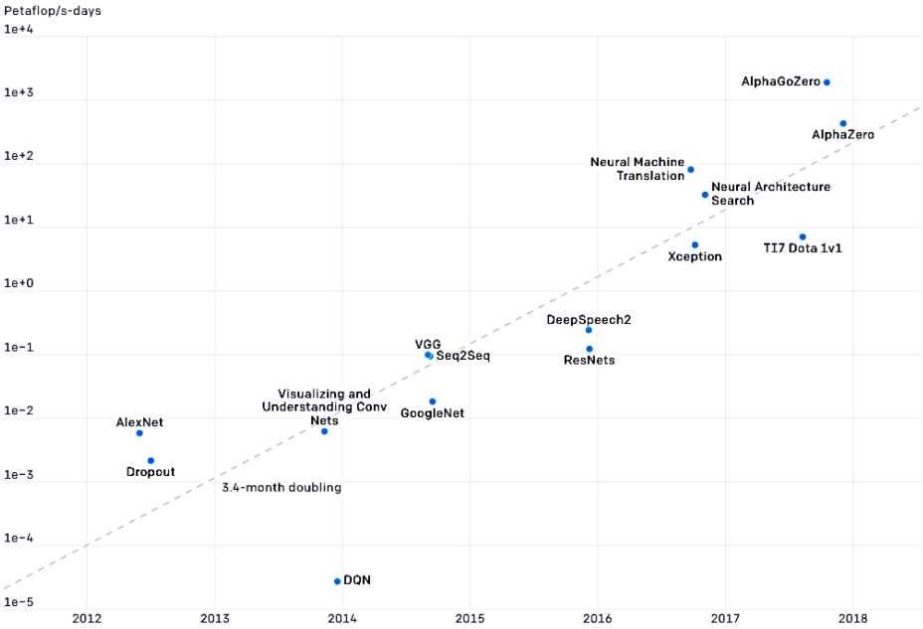
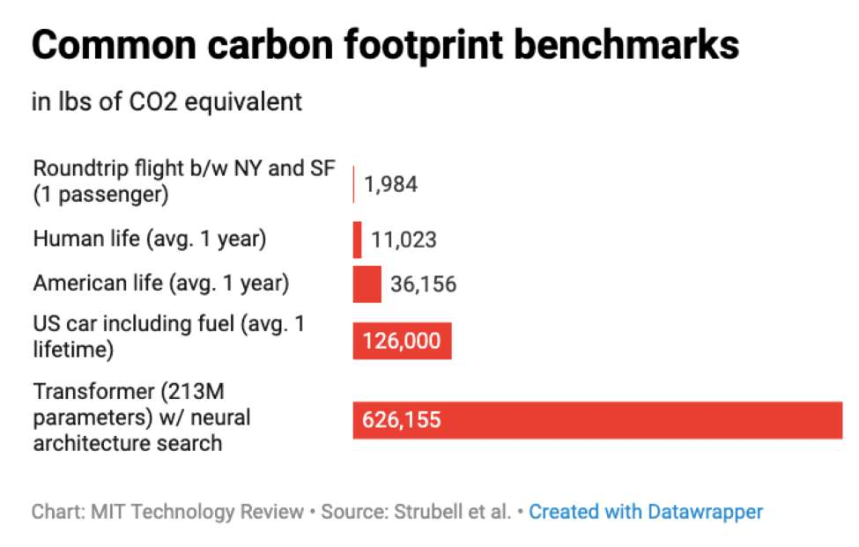
Compute Demands for Deep Neural Networks
AlexNet to AlphaGo Zero:
A 300,000x Increase in Compute
Petaflop/s-days (exponential)
[Strubell, ACL 2019]
Year
Source: Open AI (https://openai.com/blog/ai-and-compute/)
@eems_mit)
2

Slide 3

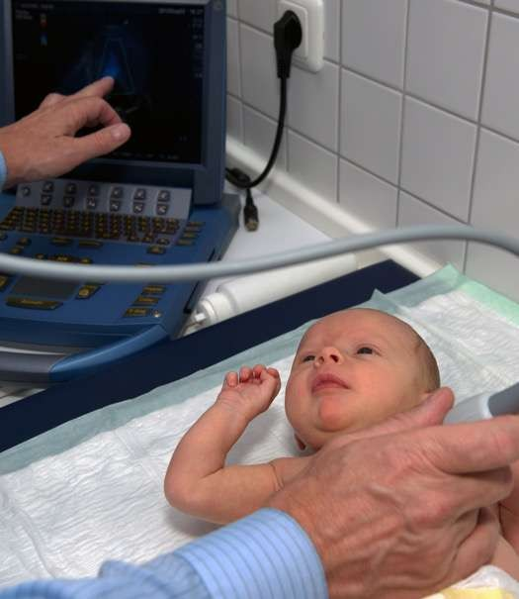
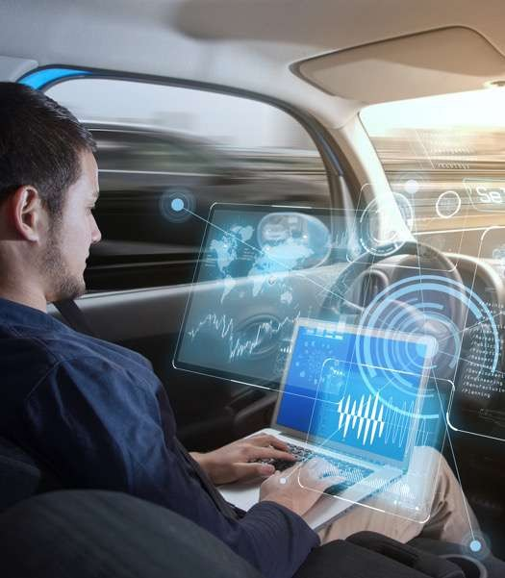
Processing at the “Edge” instead of the “Cloud”
Communication
Privacy
Latency
@eems_mit)
3

Slide 4
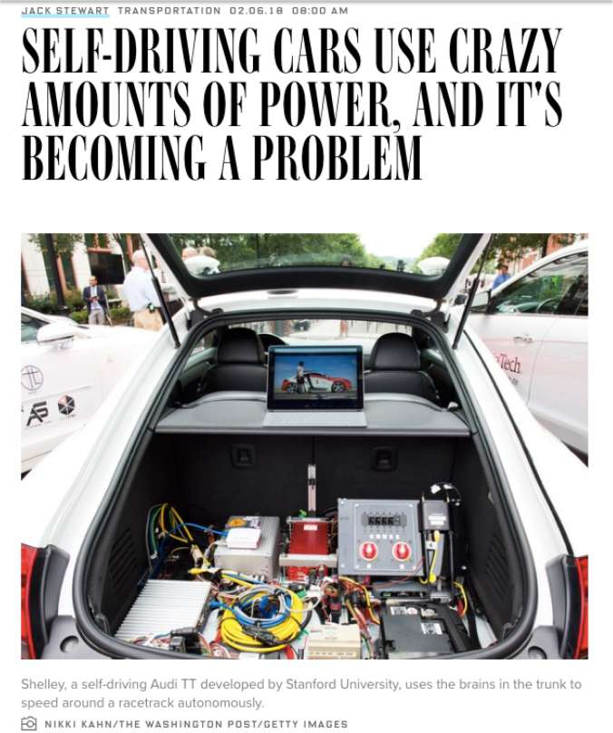

Deep Neural Networks for Self-Driving Cars
(Feb 2018)
Cameras and radar generate ~6 gigabytes of data every 30 seconds.
Prototypes use around 2,500 Watts.
Generates wasted heat and some prototypes need water-cooling!
@eems_mit)
4

Slide 5
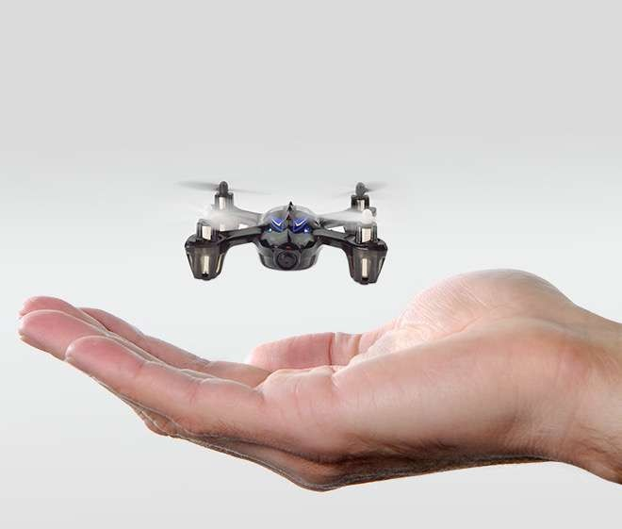
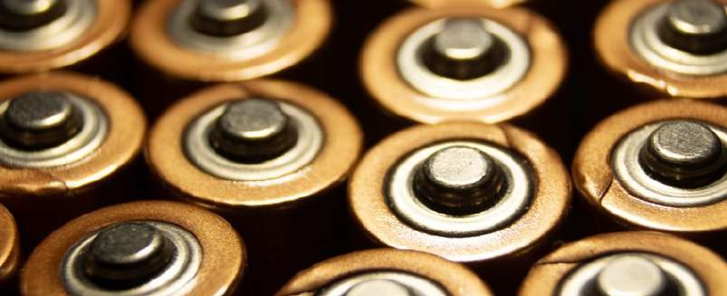
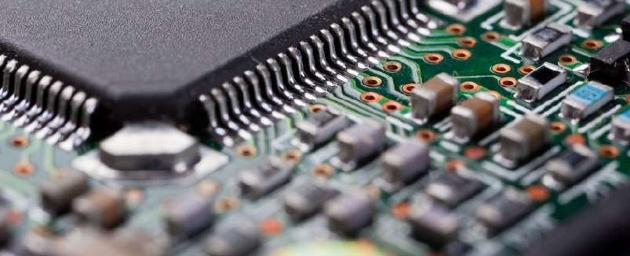
Existing Processors Consume Too Much Power
< 1 Watt
> 10 Watts
@eems_mit)
5

Slide 6
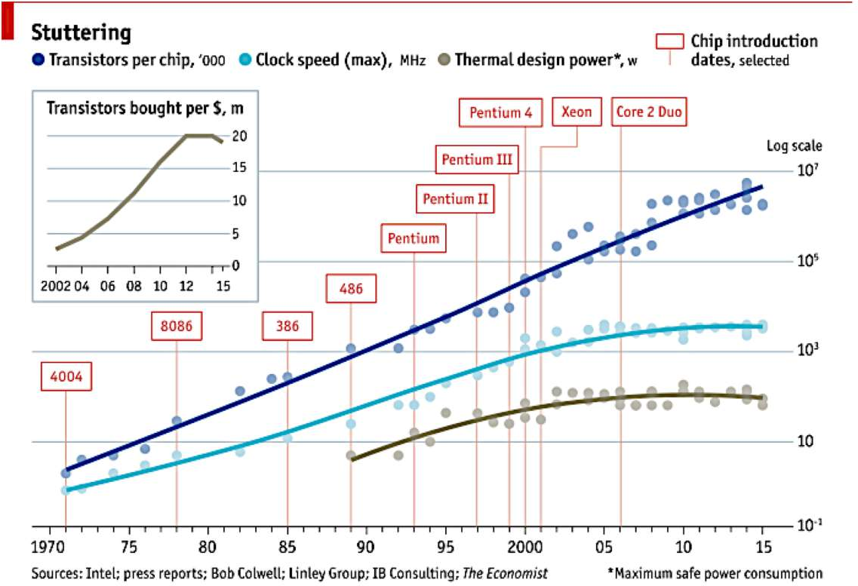
Transistors Are Not Getting More Efficient
Slowdown of Moore’s Law and Dennard Scaling General purpose microprocessors not getting faster or more efficient
Slowdown
Need specialized / domain-specific hardware for significant improvements in
speed and energy efficiency
@eems_mit)
6

Slide 7
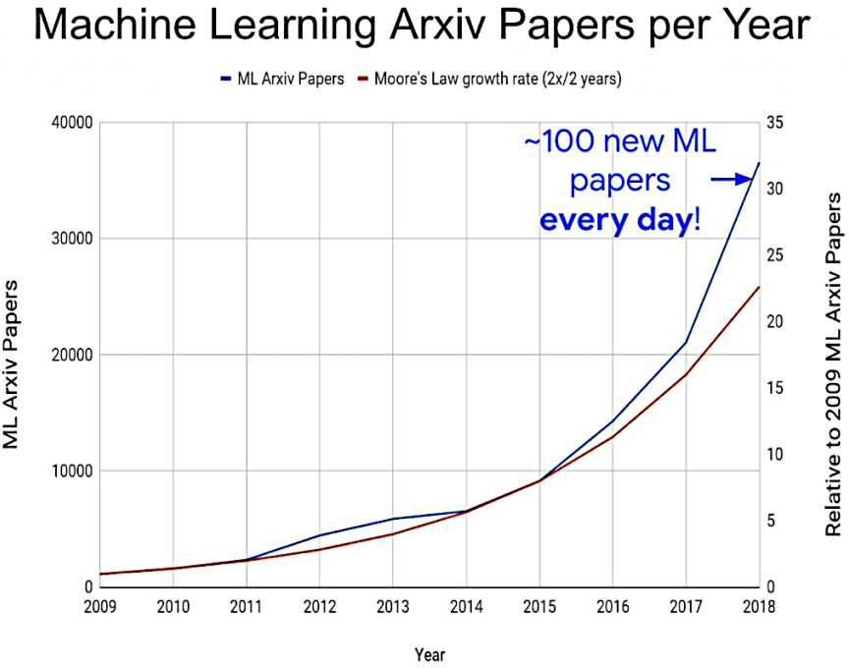
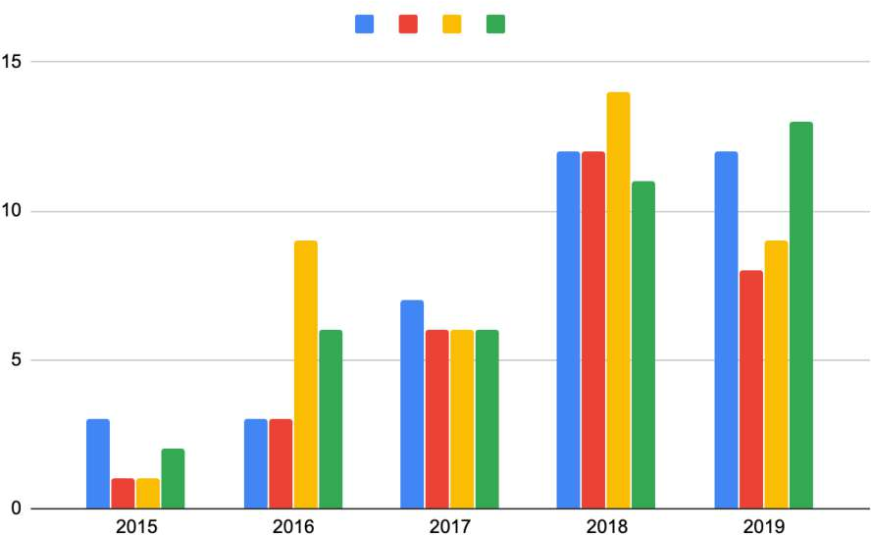






Goals of this Tutorial
□ Many approaches for efficient processing of DNNs. Too many to cover!
Number of DNN processor papers at top-tier hardware conferences
Artificial Intelligence
Machine Learning Brain-Inspired
Spiking
Neural Networks
Deep Learning
Image Source: [Sze, PIEEE 2017]
Moore’s Law
Image Source: [Dean, ISSCC 2020]
@eems_mit)
7

Slide 8

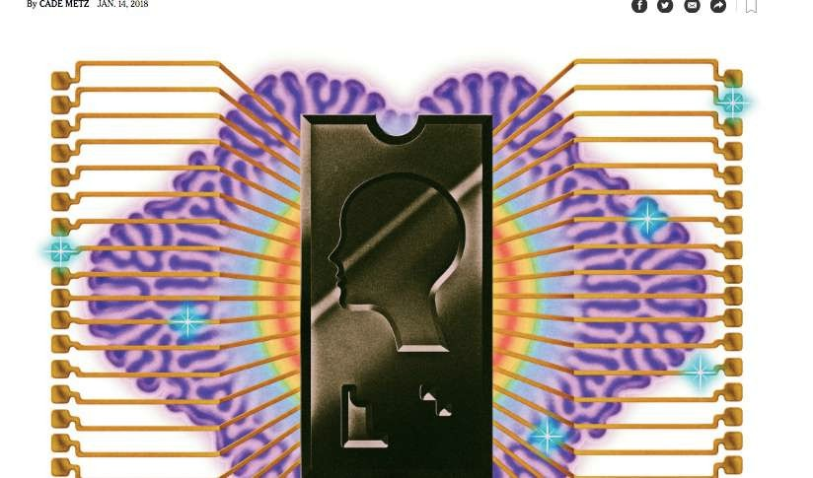
Goals of this Tutorial
□ Many approaches for efficient processing of DNNs. Too many to cover!
Big Bets On A.I. Open a New Frontier for Chips Start-Ups, Too. (January 14, 2018)
“Today, at least 45 start-ups are working on chips that can power tasks like speech and self-driving cars, and at least five of them have raised more than $100 million from investors. Venture capitalists invested more than $1.5 billion in chip start-ups last year, nearly doubling the investments made two years ago, according to the research firm CB Insights.”
Artificial Intelligence
Machine Learning Brain-Inspired
Spiking Neural Networks
Deep Learning
Image Source: [Sze, PIEEE 2017]
@eems_mit)
8

Slide 9
Goals of this Tutorial
Many approaches for efficient processing of DNNs. Too many to cover!
We will focus on how to evaluate approaches for efficient processing of DNNs
Approaches include the design of DNN hardware processors and DNN models
What are the key questions to ask?
Specifically, we will discuss
What are the key metrics that should be measured and compared?
What are the challenges towards achieving these metrics?
What are the design considerations and tradeoffs?
We will focus on inference, but many concepts covered also apply to training
@eems_mit)
9

Slide 10
Tutorial Overview
Deep Neural Networks Overview (Terminology)
Key Metrics and Design Objectives
Design Considerations
CPU and GPU Platforms
Specialized / Domain-Specific Hardware (ASICs)
Break Q&A
Algorithm (DNN Model) and Hardware Co-Design
Other Platforms
Tools for Systematic Evaluation of DNN Processors
@eems_mit)
10

Slide 11
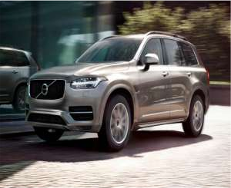
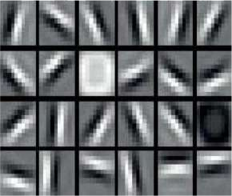
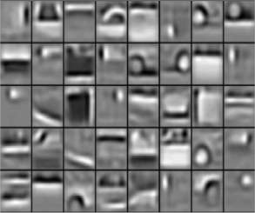
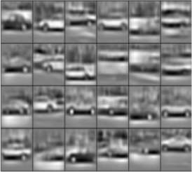
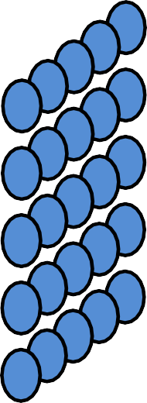














What are Deep Neural Networks?
Low Level Features
High Level Features
Input:
Image
Output:
“Volvo XC90”
Modified Image Source: [Lee, CACM 2011]
@eems_mit)
11

Slide 12
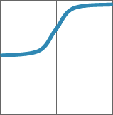


Weighted Sums
Sigmoid
Rectified Linear Unit (ReLU) 1
Nonlinear ⎛
3
⎞
X_{i} ⎮
⎠
1
Y_{j}
Activation ⎮∑W_{ij}
= activation
W
Y
Function
⎛ i=1
0
0
11
1
y=1/(1+e^{-x})
y=max(0,x)
X
-1
-1
-1
1
0
1
-1 0 1
Y₂
Image source: Caffe tutorial
X₂
Key operation is
multiply and accumulate (MAC)
Accounts for > 90% of computation
Y₃
X₃
^{W}34
Y₄
Output Layer
Input Layer
Hidden Layer
@eems_mit)
12

Slide 13

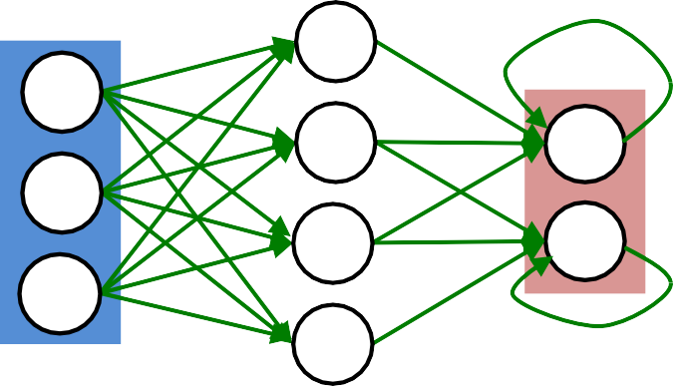

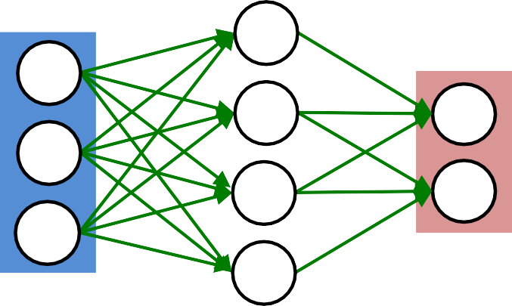
Popular Types of Layers in DNNs
Feed Forward
Feedback
Fully Connected Layer
Feed forward, fully connected
Multilayer Perceptron (MLP)
Convolutional Layer
Feed forward, sparsely-connected w/ weight sharing
Convolutional Neural Network (CNN)
Typically used for images
Recurrent Layer
Feedback
Recurrent Neural Network (RNN)
Output Layer
Input Layer
Fully Connected
Hidden Layer
Sparsely Connected
Typically used for sequential data (e.g., speech, language)
Attention Layer/Mechanism
Attention (matrix multiply) + feed forward, fully connected
Transformer [Vaswani, NeurIPS 2017]
Output Layer
Input Layer
Vivienne Sze (
@eems_mit)
NeurIPS 2019
Hidden Layer
13

Slide 14


High-Dimensional Convolution in CNN
a plane of input activations
a.k.a. input feature map (fmap)
filter (weights)
H
R
S
W
@eems_mit)

Slide 15

High-Dimensional Convolution in CNN
input fmap
filter (weights)
H
R
S
W
Element-wise Multiplication
@eems_mit)

Slide 16


High-Dimensional Convolution in CNN
output fmap
an output
input fmap
filter (weights)
activation
H
R
E
S
W
F
Element-wise Multiplication
Partial Sum (psum)
Accumulation
@eems_mit)

Slide 17
High-Dimensional Convolution in CNN
output fmap
an output
input fmap
filter (weights)
activation
H
R
E
S
W
F
Sliding Window Processing
@eems_mit)

Slide 18
High-Dimensional Convolution in CNN
input fmap
filter
C
…
…
…
output fmap
C
…
…
…
H
…
R
E
…
…
S
W
F
Many Input Channels (C)
AlexNet: 3 – 192 Channels (C)
@eems_mit)

Slide 19


High-Dimensional Convolution in CNN
input fmap
many filters (M)
output fmap
C
…
…
…
…
…
C
…
…
H
…
M
R
E
1
…
…
…
S
W
F
…
Many
Output Channels (M)
C
…
…
…
R
M
…
AlexNet: 96 – 384 Filters (M)
S
@eems_mit)

Slide 20
High-Dimensional Convolution in CNN
Many
Input fmaps (N)
Many Output fmaps (N)
filters
C
…
…
M
…
…
C
…
…
H
R
E
…
1
…
1
…
S
W
F
Image
batch size:
…
…
…
1 – 256 (N)
C
C
…
…
…
…
…
…
…
…
R
…
E
…
H
N
…
S
N
…
Vivienne Sze
( @eems_mit) NeurIPS 2019
F
20
W

Slide 21
Define Shape for Each Layer
Input fmaps
Output fmaps
Filters
C
…
M
…
…
Shape varies across layers
C
…
…
H
H – Height of input fmap (activations) W – Width of input fmap (activations) C – Number of 2-D input fmaps /filters (channels)
R – Height of 2-D filter (weights)
S – Width of 2-D filter (weights)
M – Number of 2-D output fmaps (channels)
E – Height of output fmap (activations)
F – Width of output fmap (activations)
N – Number of input fmaps/output fmaps (batch size)
R
E
1
…
1
…
1
…
S
W
F
…
…
…
C
C
M
…
…
…
…
…
…
…
R _{M}
…
E
H
N
…
S
N
……
F
W
@eems_mit)

Slide 22
Layers with Varying Shapes
MobileNetV3-Large Convolutional Layer Configurations
Block | Filter Size (RxS) | # Filters (M) | # Channels (C)
1 | 3x3 | 16 | 3
…
3 | 1x1 | 64 | 16
3 | 3x3 | 64 | 1
3 | 1x1 | 24 | 64
…
6 | 1x1 | 120 | 40
6 | 5x5 | 120 | 1
6 | 1x1 | 40 | 120
…
[Howard, ICCV 2019]
@eems_mit)

Slide 23
Popular DNN Models
Metrics | LeNet-5 | AlexNet | VGG-16 | GoogLeNet (v1) | ResNet-50 | EfficientNet-B4
Top-5 error (ImageNet) | n/a | 16.4 | 7.4 | 6.7 | 5.3 | 3.7*
Input Size | 28x28 | 227x227 | 224x224 | 224x224 | 224x224 | 380x380
# of CONV Layers | 2 | 5 | 16 | 21 (depth) | 49 | 96
# of Weights | 2.6k | 2.3M | 14.7M | 6.0M | 23.5M | 14M
# of MACs | 283k | 666M | 15.3G | 1.43G | 3.86G | 4.4G
# of FC layers | 2 | 3 | 3 | 1 | 1 | 65**
# of Weights | 58k | 58.6M | 124M | 1M | 2M | 4.9M
# of MACs | 58k | 58.6M | 124M | 1M | 2M | 4.9M
Total Weights | 60k | 61M | 138M | 7M | 25.5M | 19M
Total MACs | 341k | 724M | 15.5G | 1.43G | 3.9G | 4.4G
Reference | Lecun, PIEEE 1998 | Krizhevsky, NeurIPS 2012 | Simonyan, ICLR 2015 | Szegedy, CVPR 2015 | He, CVPR 2016 | Tan, ICML 2019
DNN models getting larger and deeper
Vivienne Sze (
@eems_mit)
* Does not include multi-crop and ensemble
** Increase in FC layers due to squeeze-and-excitation layers (much smaller than FC layers for classification)
23
NeurIPS 2019

Slide 24
Key Metrics and Design Objectives
@eems_mit)

Slide 25
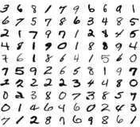
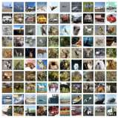
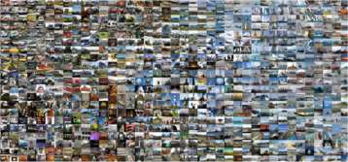
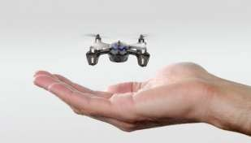
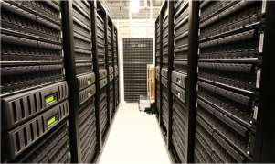
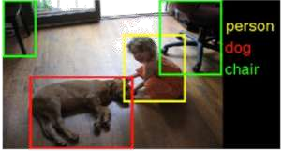

Key Metrics: Much more than OPS/W!
MNIST CIFAR-10
ImageNet
Accuracy
Quality of result
Throughput
Analytics on high volume data
Real-time performance (e.g., video at 30 fps)
Latency
For interactive applications (e.g., autonomous navigation)
Energy and Power
Embedded devices have limited battery capacity
Data centers have a power ceiling due to cooling cost
Hardware Cost
$$$
Flexibility
Range of DNN models and tasks
Scalability
Scaling of performance with amount of resources
Embedded Device
Data Center
Computer Vision
Speech Recognition
[Sze, CICC 2017]
@eems_mit)

Slide 26
Key Design Objectives of DNN Processor
Increase Throughput and Reduce Latency
Reduce time per MAC
Reduce critical path → increase clock frequency
Reduce instruction overhead
Avoid unnecessary MACs (save cycles)
Increase number of processing elements (PE) → more MACs in parallel
Increase area density of PE or area cost of system
Increase PE utilization* → keep PEs busy
Distribute workload to as many PEs as possible
Balance the workload across PEs
Sufficient memory bandwidth to deliver workload to PEs (reduce idle cycles)
Low latency has an additional constraint of small batch size
*(100% = peak performance)
@eems_mit)

Slide 27
Eyexam: Performance Evaluation Framework
MAC/cycle
Step 1: max workload parallelism (Depends on DNN Model)
Step 2: max dataflow parallelism
Number of PEs (Theoretical Peak Performance)
peak performance
A systematic way of understanding the performance limits for DNN hardware as a function of specific characteristics of the DNN model and hardware design
MAC/data
[Chen, arXiv 2019: https://arxiv.org/abs/1807.07928 ]
@eems_mit)

Slide 28
Eyexam: Performance Evaluation Framework
MAC/cycle
Slope = BW to PEs
peak performance
Number of PEs (Theoretical Peak Performance)
Based on Roofline Model
MAC/data
Bandwidth (BW) Bounded
Compute Bounded
[Williams, CACM 2009]
@eems_mit)

Slide 29
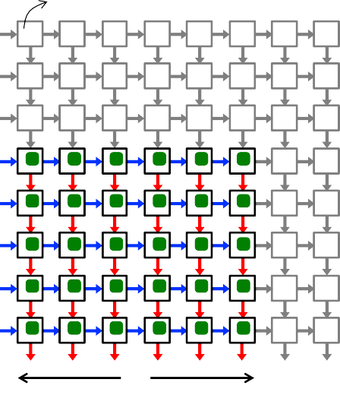
Eyexam: Performance Evaluation Framework
MAC/cycle
Step 1: max workload parallelism
Step 2: max dataflow parallelism
Number of PEs (Theoretical Peak Performance) Step 3: # of active PEs under a finite PE array size
Step 4: # of active PEs under fixed PE array dimension Step 5: # of active PEs under fixed storage capacity
peak performance
PE
MAC/data
Slope = BW to only active PE
C
https://arxiv.org/abs/1807.07928
Vivienne Sze ( @eems_mit)
NeurIPS 2019
29
M

Slide 30
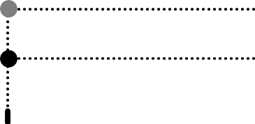
Eyexam: Performance Evaluation Framework
MAC/cycle
Step 1: max workload parallelism
Step 2: max dataflow parallelism
Number of PEs (Theoretical Peak Performance) Step 3: # of active PEs under a finite PE array size
Step 4: # of active PEs under fixed PE array dimension Step 5: # of active PEs under fixed storage capacity
Step 6: lower act. PE util. due to insufficient average BW
Step 7: lower act. PE util. due to insufficient instantaneous BW
MAC/data
peak performance
workload operational intensity
https://arxiv.org/abs/1807.07928
@eems_mit)

Slide 31
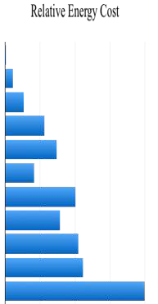
Key Design Objectives of DNN Processor
Reduce Energy and Power Consumption
Reduce data movement as it dominates energy consumption
Exploit data reuse
Reduce energy per MAC
Reduce switching activity and/or capacitance
Reduce instruction overhead
Avoid unnecessary MACs
Operation: | Energy (pJ)
8b Add | 0.03
16b Add | 0.05
32b Add | 0.1
16b FP Add | 0.4
32b FP Add | 0.9
8b Multiply | 0.2
32b Multiply | 3.1
16b FP Multiply | 1.1
32b FP Multiply | 3.7
32b SRAM Read (8KB) | 5
32b DRAM Read | 640
Relative Energy Cost
□ Power consumption is limited by heat dissipation, which limits the maximum # of MACs in parallel (i.e., throughput)
[Horowitz, ISSCC 2014]
1 10 10² 10³ 10⁴
@eems_mit)

Slide 32
Key Design Objectives of DNN Processor
Flexibility
Reduce overhead of supporting flexibility
Maintain efficiency across wide range of DNN models
Different layer shapes impact the amount of
Required storage and compute
Available data reuse that can be exploited
Different precision across layers & data types (weight, activation, partial sum)
Different degrees of sparsity (number of zeros in weights or activations)
Types of DNN layers and computation beyond MACs (e.g., activation functions)
Scalability
Increase how performance (i.e., throughput, latency, energy, power) scales with increase in amount of resources (e.g., number of PEs, amount of memory, etc.)
@eems_mit)

Slide 33
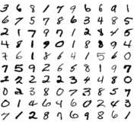
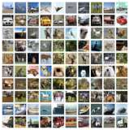

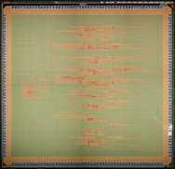


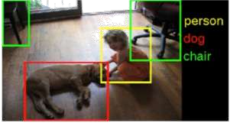
Specifications to Evaluate Metrics
Accuracy
Difficulty of dataset and/or task should be considered
Difficult tasks typically require more complex DNN models
Throughput
Number of PEs with utilization (not just peak performance)
Runtime for running specific DNN models
Latency
Batch size used in evaluation
Energy and Power
Power consumption for running specific DNN models
Off-chip memory access (e.g., DRAM)
Hardware Cost
On-chip storage, # of PEs, chip area + process technology
Flexibility
Report performance across a wide range of DNN models
Define range of DNN models that are efficiently supported
MNIST CIFAR-10
ImageNet
Chip
Off-chip memory access
DRAM
Computer Vision
Speech Recognition
[Sze, CICC 2017]
@eems_mit)

Slide 34
Comprehensive Coverage for Evaluation
All metrics should be reported for fair evaluation of design tradeoffs
Examples of what can happen if a certain metric is omitted:
Without the accuracy given for a specific dataset and task, one could run a simple DNN and claim low power, high throughput, and low cost – however, the processor might not be usable for a meaningful task
Without reporting the off-chip memory access, one could build a processor with only MACs and claim low cost, high throughput, high accuracy, and low chip power – however, when evaluating system power, the off-chip memory access would be substantial
Are results measured or simulated? On what test data?
@eems_mit)

Slide 35
Example Evaluation Process
The evaluation process for whether a DNN processor is a viable solution for a given application might go as follows:
Accuracy determines if it can perform the given task
Latency and throughput determine if it can run fast enough and in real-time
Energy and power consumption will primarily dictate the form factor of the device where the processing can operate
Cost, which is primarily dictated by the chip area, determines how much one would pay for this solution
Flexibility determines the range of tasks it can support
@eems_mit)

Slide 36
CPU & GPU Platforms
@eems_mit)

Slide 37
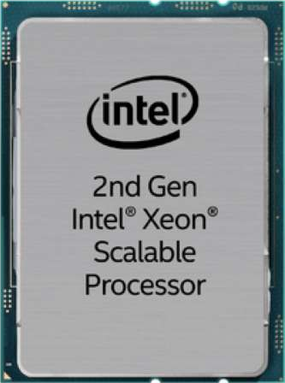
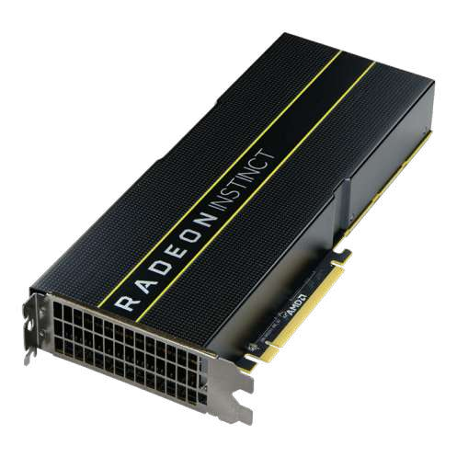
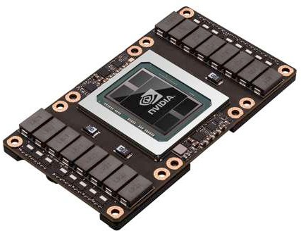
CPUs and GPUs Targeting DNNs
Intel Xeon (Cascade Lake)
Nvidia Tesla (Volta)
AMD Radeon (Instinct)
Use matrix multiplication libraries on CPUs and GPUs
@eems_mit)

Slide 38

Map DNN to a Matrix Multiplication
Fully connected layer can be directly represented as matrix multiplication
filters input fmaps
output fmaps
Filters
CHW
Input fmaps
N
Output fmaps
N
C
…
C
…
…
…
M
…
…
H
…
H
…
1
1
…
1
…
1
…
CHW
1
×
=
W
W
…
…
M
M
…
C
C
…
…
M
…
…
…
…
H
H
1
N
N
…
M
…
…
W
1
Note: Matrix multiplication also heavily used by recurrent and attention layers
W
In fully connected layer, filter size (R, S) same as input size (H, W)
@eems_mit)

Slide 39
Map DNN to a Matrix Multiplication
Convolutional layer can be converted to Toeplitz Matrix
Filter
Input Fmap
Output Fmap
Filter
Input Fmap
Output Fmap
1 | 2
3 | 4
*
1 | 2 | 3
4 | 5 | 6
7 | 8 | 9
=
1 | 2
3 | 4
1 | 2 | 3 | 4
×
1 | 2 | 4 | 5
2 | 3 | 5 | 6
4 | 5 | 7 | 8
5 | 6 | 8 | 9
=
1 | 2 | 3 | 4
Convolution
Matrix Multiply (by Toeplitz Matrix)
Data is repeated
@eems_mit)

Slide 40
CPU, GPU Libraries for Matrix Multiplication
Implementation: Matrix Multiplication (GEMM)
CPU: OpenBLAS, Intel MKL, etc
GPU: cuBLAS, cuDNN, etc
Library will note shape of the matrix multiply and select implementation optimized for that shape
Optimization usually involves proper tiling to memory hierarchy
@eems_mit)

Slide 41
Tiling Matrix Multiplication
Matrix multiplication tiled to fit in cache (i.e., on-chip memory) and computation ordered to maximize reuse of data in cache
Filters
CHW
Input fmaps
N
Output fmaps
N
Filters
CHW
Input fmaps
N
Output fmaps
N
CHW
N
N
^{F}0,0 | ^{F}0,1
^{F}1,0 | ^{F}1,1
 | ^{I}0,0 | ^{I}0,1
 | ^{I}1,0 | ^{I}1,1
F0,0I0,0 + F0,1I1,0 | F0,0I0,1 + F0,1I1,1
F1,0I0,0 | F1,0I0,1
+ | +
F1,1I1,0 | F1,1I1,1
^{F}0,0 | ^{F}0,1
^{F}1,0 | ^{F}1,1
^{I}0,0 | ^{I}0,1
^{I}1,0 | ^{I}1,1
F0,0I0,0 + F0,1I1,0 | F0,0I0,1 + F0,1I1,1
F1,0I0,0 | F1,0I0,1
+ | +
F1,1I1,0 | F1,1I1,1
CCHHW
CHW
×
W
=
×
=
M
M
M
M
Step 1
Step 2
@eems_mit)

Slide 42
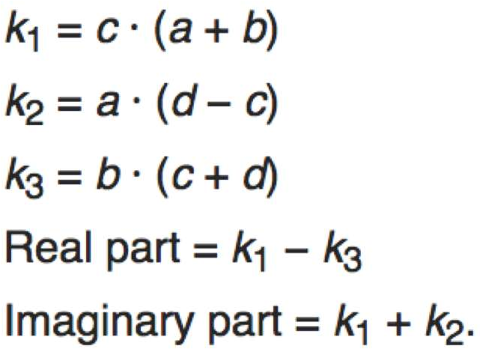
Analogy: Gauss’s Multiplication Algorithm
4 multiplications + 3 additions
3 multiplications + 5 additions
Reduce number of multiplications to
increase throughput
@eems_mit)

Slide 43
Reduce Operations in Matrix Multiplication
Fast Fourier Transform [Mathieu, ICLR 2014]
Pro: Direct convolution O(N_{o}²N_{f} ) to O(N_{o} log₂N_{o})
2 2
Con: Increase storage requirements
Strassen [Cong, ICANN 2014]
Pro: O(N³) to (N^{2.807})
Con: Numerical stability
Winograd [Lavin, CVPR 2016]
Pro: 2.25x speed up for 3x3 filter
Con: Specialized processing depending on filter size
Compiler selects transform based on filter size
@eems_mit)

Slide 44
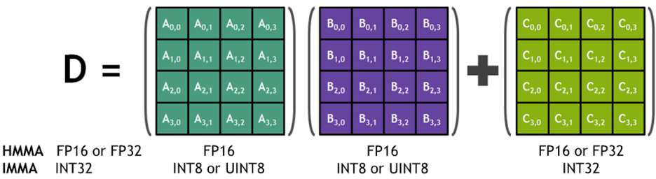
Reduce Instruction Overhead
Perform more MACs per instruction
CPU: SIMD / Vector Instructions
e.g., Specialized Vector Neural Network Instructions (VNNI) fuse separate multiply and add instructions into single MAC instruction and avoid storing intermediate values in memory
GPU: SIMT / Tensor Instructions
e.g., New opcode Matrix Multiply Accumulate (HMMA) performs 64 MACs with Tensor Core
Perform more MACs per cycle without increasing memory bandwidth by adding support for reduced precision
e.g., If access 512 bits per cycle, can perform 64 8-bit MACs vs. 16 32-bit MACs
Tensor Core
Image Source: Nvidia
@eems_mit)

Slide 45
Design Considerations for CPU and GPU
Software (compiler)
Reduce unnecessary MACs: Apply transforms
Increase PE utilization: Schedule loop order and tile data to increase data reuse in memory hierarchy
Hardware
Reduce time per MAC
Increase speed of PEs
Increase MACs per instruction using large aggregate instructions (e.g., SIMD, tensor core)
→ requires additional hardware
Increase number of parallel MACs
Increase number of PEs on chip → area cost
Support reduced precision in PEs
Increase PE utilization
Increase on-chip storage → area cost
External memory BW → system cost
@eems_mit)

Slide 46
Specialized / Domain- Specific Hardware
@eems_mit)

Slide 47




Properties We Can Leverage
Operations exhibit high parallelism
→ high throughput possible
Memory Access is the Bottleneck
Memory Read MAC*
Memory Write
DRAM
filter weight fmap act partial sum
ALU
DRAM
updated partial sum
200x 1x
* multiply-and-accumulate
Worst Case: all memory R/W are DRAM accesses
Example: AlexNet has 724M MACs → 2896M DRAM accesses required
@eems_mit)

Slide 48
Properties We Can Leverage
Operations exhibit high parallelism
→ high throughput possible
Input data reuse opportunities (e.g., up to 500x for AlexNet)
→ exploit low-cost memory
Input Fmaps
Input Fmap Filters
Filter
Filter
Input Fmap
1
1
2
2
Convolutional Reuse (Activations, Weights) CONV layers only
Fmap Reuse
(Activations) CONV and FC layers
Filter Reuse
(Weights)
(sliding window)
CONV and FC layers (batch size > 1)
48
Vivienne Sze ( @eems_mit)
NeurIPS 2019

Slide 49

Highly-Parallel Compute Paradigms
Temporal Architecture (SIMD/SIMT)
Spatial Architecture (Dataflow Processing)
Memory Hierarchy
Memory Hierarchy
Register File
ALU
ALU
ALU
ALU
ALU
ALU
ALU
ALU
ALU
ALU
ALU
ALU
ALU
ALU
ALU
ALU
ALU
ALU
ALU
ALU
ALU
ALU
ALU
ALU
ALU
ALU
ALU
ALU
Control
ALU
ALU
ALU
ALU
Vivienne Sze (
@eems_mit)
NeurIPS 2019
49

Slide 50

Advantages of Spatial Architecture
Temporal Architecture
(SIMD/SIMT)
Spatial Architecture (Dataflow Processing)
Efficient Data Reuse
Distributed local storage (RF)
Memory Hierarchy
Memory Hierarchy
Register File
Inter-PE Communication
Sharing among regions of PEs
ALU
ALU
ALU
ALU
ALU ALU ALU ALU
ALU ALU ALU ALU
ALU ALU ALU ALU ALU ALU ALU ALU
Control
ALU
ALU
ALU
ALU
Processing Element (PE)
ALU
ALU
ALU
ALU
0.5 – 1.0 kB
Reg File
ALU
ALU
ALU
ALU
Control
@eems_mit)

Slide 51
How to Map the Dataflow?
Spatial Architecture (Dataflow Processing)
CNN Convolution
Memory Hierarchy
partial sums
?
ALU
ALU
ALU
ALU
activations weights
ALU
ALU
ALU
ALU
ALU
ALU
ALU
ALU
Goal: Increase reuse of input data (weights and activations) and local partial sums accumulation
ALU
ALU
ALU
ALU
@eems_mit)

Slide 52
Efficient Dataflows
Y.-H. Chen, J. Emer, V. Sze,
“Eyeriss: A Spatial Architecture for Energy-Efficient Dataflow for Convolutional Neural Networks,”
International Symposium on Computer Architecture (ISCA), June 2016.
@eems_mit)

Slide 53
















Data Movement is Expensive
DRAM
Specialized hardware with small (< 1kB) low cost memory near compute
PE
PE
Global
Buffer
PE
ALU
fetch data to run a MAC here
Normalized Energy Cost*
ALU
1× (Reference)
Farther and larger memories consume more power
0.5 – 1.0 kB
RF
ALU
1×
NoC: 200 – 1000 PEs
PE
ALU
2×
Maximize data reuse at low cost levels of memory hierarchy
100 – 500 kB
Buffer
ALU
6×
DRAM
ALU
200×
* measured from a commercial 65nm process
@eems_mit)

Slide 54







Weight Stationary (WS)
[Chen, ISCA 2016]
Global Buffer
Psum
Activation
W0
W1
W2
W3
W4
W5
W6
W7
PE
Weight
Minimize weight read energy consumption
− maximize convolutional and filter reuse of weights
Broadcast activations and accumulate partial sums spatially
across the PE array
• Examples: TPU [Jouppi, ISCA 2017], NVDLA
@eems_mit)

Slide 55










Output Stationary (OS)
[Chen, ISCA 2016]
Global Buffer
Activation Weight
P0
P1
P2
P3
P4
P5
P6
P7
PE
Psum
Minimize partial sum R/W energy consumption
− maximize local accumulation
Broadcast/Multicast filter weights and reuse activations spatially
across the PE array
• Examples: [Moons, VLSI 2016], [Thinker, VLSI 2017]
@eems_mit)

Slide 56
Input Stationary (IS)
[Chen, ISCA 2016]
Global Buffer
Weight Psum
I0 I1 I2 I3 I4 I5 I6 I7
Act
PE
Minimize activation read energy consumption
− maximize convolutional and fmap reuse of activations
Unicast weights and accumulate partial sums spatially
across the PE array
• Example: [SCNN, ISCA 2017]
@eems_mit)

Slide 57
Row Stationary Dataflow
Maximize row convolutional reuse in RF
− Keep a filter row and fmap sliding window in RF
Maximize row psum accumulation in RF
Reg File
c b a
e d c
PE
1D convolution within PE
b
a
c
[Chen, ISCA 2016]
57
@eems_mit)

Slide 58



























Row Stationary Dataflow
Row 1
Row 2
Row 3
PE 1
PE 4
PE 7
Row 1
*
Row 1
Row 1
*
Row 2
Row 1
*
Row 3
PE 2
PE 5
PE 8
Optimize for
overall energy efficiency instead for only a certain data type
Row 2
*
Row 2
Row 2
*
Row 3
Row 2
*
Row 4
PE 3
PE 6
PE 9
Row 3
*
Row 3
Row 3
*
Row 4
Row 3
*
Row 5
* * *
=
=
=
[Chen, ISCA 2016]
58
@eems_mit)

Slide 59
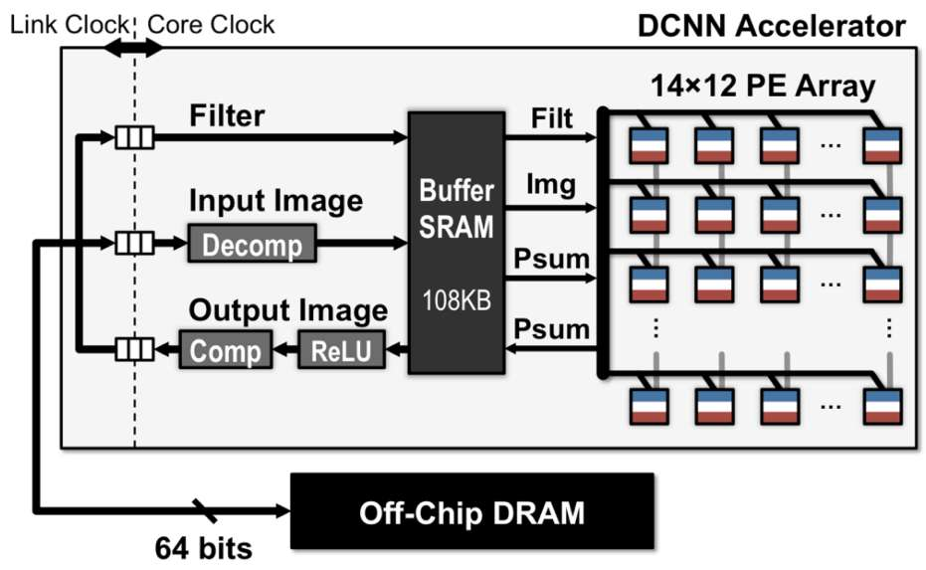
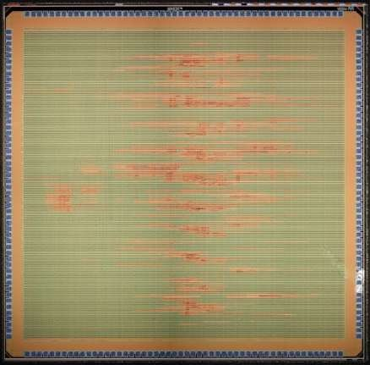
Eyeriss: Deep Neural Network Accelerator
4mm
Spatial PE Array
On-chip Buffer
4mm
[Chen, ISSCC 2016]
Exploits data reuse for 100x reduction in memory accesses from global buffer and 1400x reduction in memory accesses from off-chip DRAM
Overall >10x energy reduction compared to a mobile GPU (Nvidia TK1)
Vivienne Sze ( @eems_mit) NeurIPS 2019
Results for AlexNet
59

Slide 60

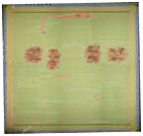
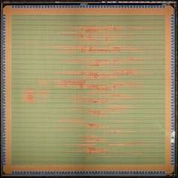




Features: Energy vs. Accuracy
Exponential
10000 VGG16²
Measured in 65nm*
4mm
4mm
1000
On-chip Buffer
Spatial
AlexNet
2
4mm
PE Array
Energy/Pixel (nJ)
4mm
100
10
1 [Suleiman, VLSI 2016] 2 [Chen, ISSCC 2016]
* Only feature extraction. Does not include data, classification energy, augmentation and ensemble, etc.
Video Compression
1
HOG¹
Linear
0.1
0
20
40 60
Accuracy (Average Precision)
80
[Suleiman, ISCAS 2017]
Vivienne Sze ( @eems_mit)
Measured in on VOC 2007 Dataset
1. DPM v5 [Girshick, 2012]
NeurIPS 2019
2. Fast R-CNN [Girshick, CVPR 2015]
60

Slide 61
Break for Q&A
@eems_mit)

Slide 62
Algorithm (DNN Model) & Hardware Co-Design
@eems_mit)

Slide 63
Algorithm & Hardware Co-Design
Co-design algorithm + hardware → better than what each could achieve alone
Co-design approaches can be loosely grouped into two categories:
Reduce size of operands for storage/compute (Reduced Precision)
Reduce number of operations for storage/compute (Sparsity and Efficient Network Architecture)
Hardware support required to increase savings in latency and energy
Ensure that overhead of hardware support does not exceed benefits
Unlike previously discussed approaches, these approaches can affect accuracy!
Evaluate tradeoff between accuracy and other metrics
@eems_mit)

Slide 64
Reduced Precision
@eems_mit)

Slide 65




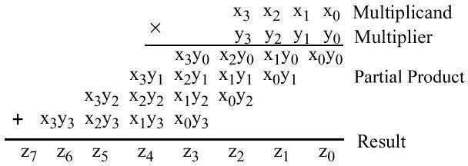
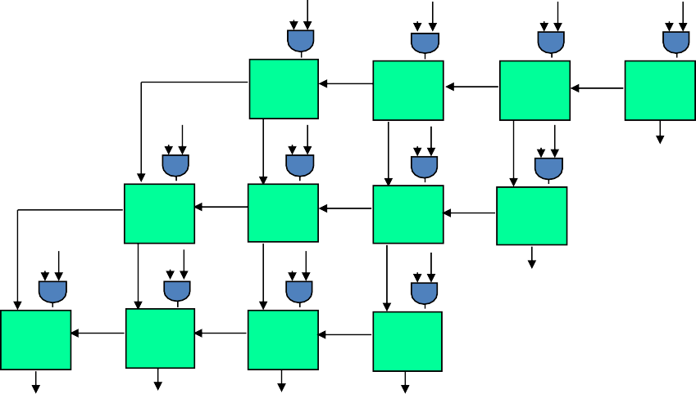
Why Reduce Precision (i.e., Reduce Bit Width)?
Reduce data movement and storage cost for inputs and outputs of MAC
Smaller memory → lower energy
Reduce cost of MAC
Cost of multiply increases with bit width (n) → energy and area by O(n²); delay by O(n)
x₃
x₂
x₁
x₀
y₀
x₃
x₂
x₁
x₀
y₁
z₀
HA
FA
FA
HA
x₃
x₂
x₁
x₀
y₂
z₁
FA
FA
FA
HA
x₃
x₂
x₁
x₀
y₃
z₂
FA
FA
FA
HA
z₇ z₆ z5 z₄
z₃
Note: Bit width for multiplication and accumulation in a MAC are different
@eems_mit)

Slide 66
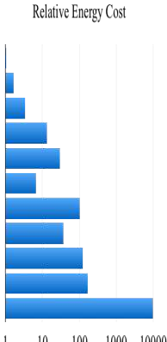
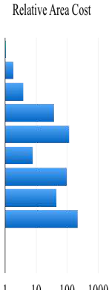
Impact of Reduced Precision on Energy & Area
Area (μm²)
36
67
137
1360
4184
282
3495
1640
7700
N/A
N/A
Operation: | Energy (pJ)
8b Add | 0.03
16b Add | 0.05
32b Add | 0.1
16b FP Add | 0.4
32b FP Add | 0.9
8b Mult | 0.2
32b Mult | 3.1
16b FP Mult | 1.1
32b FP Mult | 3.7
32b SRAM Read (8KB) | 5
32b DRAM Read | 640
Relative Energy Cost Relative Area Cost
[Horowitz, ISSCC 2014]
1 10 10² 10³ 10⁴
1 10 10² 10³
@eems_mit)

Slide 67
What Determines Bit Width?
Number of unique values
e.g., M-bits to represent 2^{M} values
Dynamic range of values
e.g., E-bits to scale values by 2^{(E-127)}
Signed or unsigned values
e.g., signed requires one extra bit (S)
Total bits = S+E+M
Common Numerical Representations
1 8
23
Range
FP32
S | E | M
₁₀-38 _{– 10}38
1
5
10
FP16
S | E | M
6x10⁻⁵ - 6x10⁴
1
31
Int32
S
M
0 – 2x10⁹
Floating point (FP) allows range to change for each value (E-bits)
Fixed point (Int) has fixed range
1
15
Int16
S
M
0 – 6x10⁴
1
7
Int8
S
M
0 – 127
□ Default CPU/GPU is 32-bit float (FP32)
Image Source: B. Dally
@eems_mit)

Slide 68
What Determines Bit Width?
For accuracy, require sufficient precision to represent different data types
For inference: weights, activations, and partial sums
For training: weights, activations, partial sums, gradients,
and weight update
Required precision can vary across data types
□ Referred to as mixed precision
@eems_mit)

Slide 69
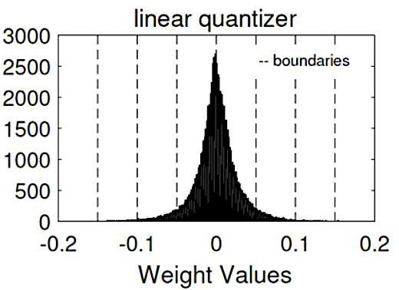
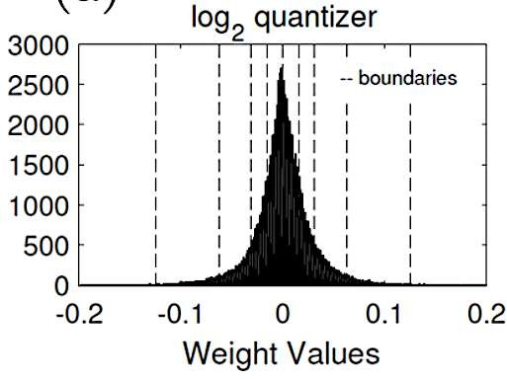
What Determines Bit Width?
Reduce number of unique values (M-bits, a.k.a. mantissa)
Default: Uniform quantization (values are equally spaced out)
Non-uniform quantization (spacing can be computed, e.g., logarithmic, or with look-up-table)
Fewer unique values can make transforms and compression more effective
Image Source:[Lee, ICASSP 2017]
@eems_mit)

Slide 70
What Determines Bit Width?
Reduce number of unique values (M-bits, a.k.a. mantissa)
Default: Uniform quantization (values are equally spaced out)
Non-uniform quantization (spacing can be computed, e.g., logarithmic, or with look-up-table)
Fewer unique values can make transforms and compression more effective
Reduce dynamic range (E-bits, a.k.a., exponent)
If possible, fix range (i.e., used fixed point, E=0)
Share range across group of values (e.g., weights for a layer or channel)
Tradeoff between number of bits allocated to M-bits and E-bits
fp16 (S=1, E=5, M=10)
bfloat16 (S=1, E=8, M=7)
S | E | E | E | E | E | M | M | M | M | M | M | M | M | M | M
range: ~5.9e⁻⁸ to ~6.5e⁴
range: ~1e⁻³⁸ to ~3e³⁸
S | E | E | E | E | E | E | E | E | M | M | M | M | M | M | M
@eems_mit)

Slide 71
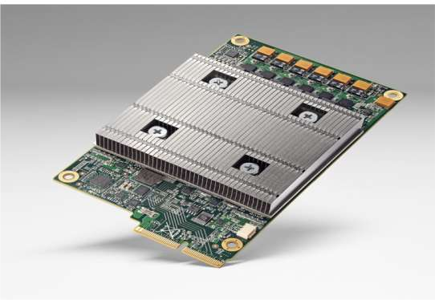
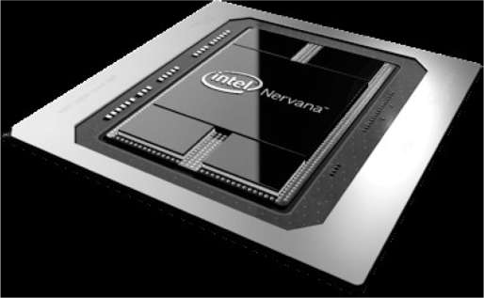
Commercial Products Support Reduced Precision
Nvidia’s Pascal (2016)
Google’s TPU (2016) TPU v2 & v3 (2019)
Intel’s NNP-L (2019)
8-bit fixed for Inference & 16-bit float for Training
@eems_mit)

Slide 72

Reduced Precision in Research
Reduce number of bits
Binary Nets [Courbariaux, NeurIPS 2015]
Reduce number of unique weights and/or activations
Ternary Weight Nets [Li, NeurIPS Workshop 2016]
XNOR-Net [Rategari, ECCV 2016]
Non-Linear Quantization
Binary Filters
LogNet [Lee, ICASSP 2017]
Log Domain Quantization
Training
8-bit with stochastic rounding
[Wang, NeurIPS 2018]
@eems_mit)

Slide 73



Precision Scalable MACs for Varying Precision
Evaluation of 19 precision scalable MAC designs
5% of values 8bx8b
95% of values at 2bx2b and 4bx4b
Full precision 8bx8b
4bx4b
2bx8b
4bx4b
Conventional
1.3x
data-gated
1.6x
Conventional data-gated MAC Gate unused logic (e.g., full adders) to reduce energy consumption
[Camus, JETCAS 2019]
Many approaches add logic to increase utilization for higher throughput/area; however, overhead can reduce benefits
@eems_mit)

Slide 74
Design Considerations for Reduced Precision
Impact on accuracy
Must consider difficulty of dataset, task, and DNN model
e.g., Easy to reduce precision for an easy task (e.g., digit classification); does method work for a more difficult task?
Does hardware cost exceed benefits?
Need extra hardware to support variable precision
e.g., Additional shift-and-add logic and registers for variable precision
Granularity impacts hardware overhead as well as accuracy
e.g., More overhead to support (1b, 2b, 3b … 16b) than (2b, 4b, 8b, 16b)
Evaluation
Use 8-bit for inference and 16-bit float for training for baseline
32-bit float is a weak baseline
@eems_mit)

Slide 75
Sparsity
@eems_mit)

Slide 76
Why Increase Sparsity?
Reduce number of MACs
Anything multiplied by zero is zero → avoid performing unnecessary MACs
Reduce energy consumption and latency
Reduce data movement
If one of the inputs to MAC is zero, can avoid reading the other input
Compress data by only sending non-zero values
CPU/GPU libraries typically only support really high sparsity (> 99%) due to the overhead
Sparsity for DNNs typically much lower → need specialized hardware
@eems_mit)

Slide 77


Sparsity in Activation Data
Many zeros in output fmaps after ReLU
ReLU
9 | -1 | -3
1 | -5 | 5
-2 | 6 | -1
9 | 0 | 0
1 | 0 | 5
0 | 6 | 0
# of activations
# of non-zero activations
1
0.8
0.6
0.4
0.2
0
(Normalized)
1
2
3
CONV Layer
4
5
[Chen, ISSCC 2016]
@eems_mit)

Slide 78







Data Gating / Zero Skipping
Gate operations
(reduce power consumption)
Skip operations
(increase throughput)
Skip MAC and mem reads
Image Scratch Pad (12x16b REG)
when image data is zero.
Reduce PE power by 45%
Img
Zero
2-stage pipelined multiplier
Accumulate Input Psum
== 0
Enable
Buffer
Filt
Filter Scratch Pad
(225x16b SRAM)
Output Psum
0
Input Psum
1
Partial Sum
0
1
Scratch Pad
0
(24x16b REG)
Reset
Eyeriss [Chen, ISSCC 2016]
Cnvlutin [Albericio, ISCA 2016]
@eems_mit)

Slide 79























Apply Compression to Reduce Data Movement
Example: Eyeriss compresses activations to reduce DRAM BW
DNN Accelerator
DCNN Accelerator
Link Clock Core Clock
14×12 PE Array
Filter Filt
…
Input Image ^{Buffer Img} …
SRAM
Psum
…
Output Image ^{108KB}
Psum … …
ReLU
…
1.2×
Run-Length Compression (RLC)
Example:
Input: 0, 0, 12, 0, 0, 0, 0, 53, 0, 0, 22, …
6
4
2
0
1.4×
1.7×
DRAM
Access (MB)
1.8×
Uncompressed Fmaps + Weights
RLE Compressed Fmaps + Weights
Decomp
1.9×
Output (64b):
RunLevelRunLevel RunLevelTerm
2 12 4 53 2 22 0
5b 16b 5b 16b 5b 16b 1b
Comp
1 2 3 4 5
AlexNet Conv Layer
Off-Chip DRAM
64 bits
Simple RLC within 5% - 10% of theoretical entropy limit
[Chen, ISSCC 2016]
@eems_mit)

Slide 80










Pruning – Make Weights Sparse
Optimal Brain Damage
Prune DNN based on
magnitude of weights
before pruning after pruning
pruning synapses
pruning neurons
retraining
Example: AlexNet
Weight Reduction: CONV layers 2.7x,
FC layers 9.9x
Overall Reduction: Weights 9x, MACs 3x
[Han, NeurIPS 2015]
[Lecun, NeurIPS 1990]
@eems_mit)

Slide 81

Unstructured or Structured Sparsity
Increase coarseness
Image Source: [Mao, CVPR Workshop 2017]
Benefits:
Increase coarseness → more structure in sparsity (easier for hardware) Less signaling overhead for location of zeros → better compression
@eems_mit)

Slide 82
Design Considerations for Sparsity
Impact on accuracy
Must consider difficulty of dataset, task, and DNN model
e.g., AlexNet and VGG known to be over parameterized and thus easy to prune weights; does method work on efficient DNN models?
Does hardware cost exceed benefits?
Need extra hardware to identify sparsity
e.g., Additional logic to identify non-zeros and store non-zero locations
Accounting for sparsity in both weights and activations is challenging
Need to compute intersection of two data streams rather than find next non-zero in one
Granularity impacts hardware overhead as well as accuracy
e.g., Fine-grained or coarse-grained (structured) sparsity
Compressed data will be variable length
Reduced flexibility in access order → random access will have significant overhead
@eems_mit)

Slide 83
Efficient Network Architectures
@eems_mit)

Slide 84


Efficient DNN Models
Design efficient DNN Models
Tends to increase variation of layer shapes (e.g., R, S, C) that need to be supported
Can be handcrafted or learned using Network/Neural Architecture Search (NAS)
Filter Decomposition 1x1 convolutions
Filter Decomposition
Bottleneck Layer
C
Decompose large filters into smaller filters
…
…
Reduce number of channels before large filter convolution
* ₁
C
R
R
…
…
…
S
S
1
 | Year | Accuracy* | # Layers | # Weights | # MACs
AlexNet | 2012 | 80.4% | 8 | 61M | 724M
MobileNet | 2017 | 89.5% | 28 | 4M | 569M
[1]
* ImageNet Classification Top-5
@eems_mit)

Slide 85
Manual Network Design
Reduce Spatial Size (R, S)
stacked filters
Reduce Channels (C)
1x1 convolution, group of filters
Reduce Filters (M)
feature map reuse across layers
Layer Pooling
global pooling before FC layer
Input fmaps
Output fmaps
Filters
C
…
M
…
…
C
…
…
H
E
R
1
…
1
1
…
…
S
W
F
…
…
…
C
C
M
…
…
…
…
…
…
R _{M}
…
…
E
H
N
…
S
N
……
F
W
@eems_mit)

Slide 86
Reduce Spatial Size (R, S): Stacked Filter
5x5 filter
Apply sequentially
5x1 filter
1x5 filter
decompose
GoogleNet/ Inception v3
separable filters
5x5 filter
Two 3x3 filters
Apply sequentially
decompose
VGG
Replace a large filter with a series of smaller filters
@eems_mit)

Slide 87




Reduce Channels (C): 1x1 Convolution
Use 1x1 filter to summarize cross-channel information
filter₁ (1x1x64)
56
56
1
Modified image from source:
Stanford cs231n
[Lin, ICLR 2014]
@eems_mit)

Slide 88





Reduce Channels (C): 1x1 Convolution
Use 1x1 filter to summarize cross-channel information
filter₂ (1x1x64)
56
56
2
Modified image from source:
Stanford cs231n
[Lin, ICLR 2014]
88
@eems_mit)

Slide 89


Reduce Channels (C): 1x1 Convolution
Use 1x1 filter to summarize cross-channel information
56
56
32
Modified image from source:
Stanford cs231n
[Lin, ICLR 2014]
89
@eems_mit)

Slide 90

GoogLeNet:1x1 Convolution
Apply 1x1 convolution before ‘large’ convolution filters.
Reduce weights such that entire CNN can be trained on one GPU.
Number of multiplications reduced from 854M → 358M
Inception Module
1x1 convolutions to reduce number of weights and multiplications
[Szegedy, CVPR 2015]
@eems_mit)
90

Slide 91
Reduce Channels (C): Group of Filters
input fmap
C
…
…
…
_{C/2} filter₁
output fmap₁
…
…
H
…
Split filters and channels of feature map into different groups
R
E
…
…
S
W
F
e.g., For two groups, each filter requires 2x fewer weights and multiplications
input fmap
_{C/2} filter₂
C
…
…
…
…
…
…
output fmap₂
R
H
…
…
E
S
…
W
F
@eems_mit)

Slide 92
Reduce Channels (C): Group of Filters
input fmap
C
…
…
…
filter₁
output fmap₁
H
…
R
E
The extreme case is depthwise convolution – each group contains only one channel
S
…
W
F
input fmap
filter_{C}
C
…
…
…
…
output fmap_{C}
R
…
H
E
S
…
W
F
@eems_mit)

Slide 93





Reduce Channels (C): Group of Filters
Two ways of mixing information across groups
fmap 0
layer 1
fmap 1
R
R
+ 1
C
1
C
S
1
S
layer 2
fmap 2
Pointwise (1x1) Convolution (Mix in one step)
MobileNet [Howard, arXiv 2017]
Shuffle Operation (Mix in multiple steps)
ShuffleNet [Zhang, CVPR 2018]
@eems_mit)

Slide 94


Reduce Filters (M): Feature Map Reuse
M Filters
L 1
L 2
L 3
C
DenseNet reuses feature map from multiple layers
[Huang, CVPR 2017]
…
…
R
1
…
Output fmap with M channels
S
…
K
M-K
C
…
…
……
R
K
…
M
S
E
…
^{C}… …
R
M …
S
……
F
Reuse (M-K) channels in feature maps from previously processed layers
…
@eems_mit)

Slide 95

Layer Pooling: Simplify FC Layers
[Krizhevsky, NeurIPS 2012]
First FC layer accounts for a significant portion of weights
38M of 61M for AlexNet
1000
scores
224x224
Input Image
Conv (11x11) | Non-Linearity | Norm (LRN) | Max Pool
Conv (5x5) | Non-Linearity | Norm (LRN) | Max Pooling
Conv (3x3) Non-Linearity
Fully Connect
L1
L2
L3
Conv (3x3) Non-Linearity
L4
Conv (3x3) Non-Linearity Max Pooling
L5
Fully Connect Non-Linearity
L6
Fully Connect Non-Linearity
L7
# of weights
34k
307k
224M
885k
150M
664k
112M
442k
75M
38M 16.8M 4.1M
38M 17M 4M
37.7M
# of MACs
105M
@eems_mit)

Slide 96
Layer Pooling: Simplify FC Layers
filter₁ input fmap
C C
…
…
output fmap₁
H
…
H
…
1
…
1
W
W
Global Pooling reduces the size of the input to the first FC layer, which reduces its size
(e.g., HxWxCx1000 → 1x1xCx1000)
input fmap
C
output fmap₁
H
…
Pool
1
[Lin, ICLR 2014]
1
W
@eems_mit)
96

Slide 97





Network/Neural Architecture Search (NAS)
Rather than handcrafting the architecture, automatically search for it
Pool? CONV?
128 Filters?
3x3? 5x5?
@eems_mit)
97

Slide 98
Network/Neural Architecture Search (NAS)
Three main components:
Search Space (what is the set of all samples)
Optimization Algorithm (where to sample)
Performance Evaluation (how to evaluate samples)
Search Space
Sampled Network
Next Location to Sample
Performance Evaluation
Optimization Algorithm
Final Network
Evaluation Result
Key Metrics: Achievable DNN accuracy and required search time
@eems_mit)
98

Slide 99
Evaluate NAS Search Time
Search Space
Performance Evaluation
Optimization Algorithm
^{𝑡i𝑚𝑒}𝑛𝑎𝑠 ^{= 𝑛𝑢𝑚}𝑠𝑎𝑚𝑝𝑙𝑒𝑠 ^{× 𝑡i𝑚𝑒}𝑝𝑒𝑟_𝑠𝑎𝑚𝑝𝑙𝑒
𝑡i𝑚𝑒_{𝑛𝑎𝑠} 𝖺
^{𝑛𝑢𝑚}𝑛𝑎𝑠_𝑡𝑢𝑛i𝑛𝑔 ^{× 𝑛𝑢𝑚}𝑛𝑎𝑠_𝑠𝑡𝑒𝑝𝑠 ^{× 𝑠i1𝑒}𝑠𝑒𝑎𝑟𝑐3_𝑠𝑝𝑎𝑐𝑒
× (𝑡i𝑚𝑒_{𝑡𝑟𝑎i𝑛} + 𝑡i𝑚𝑒_{𝑒𝑣𝑎𝑙})
(2) Improve the optimization algorithm
(1) Shrink the search space
(3) Simplify the performance
evaluation
Goal: Improve the efficiency of NAS in the three main components
@eems_mit)
99

Slide 100
(1) Shrink the Search Space
□ Trade the breadth of architectures for search speed
Architecture Universe
Optimal
□ May limit the performance that can be achieved
Optimal
□ Use domain knowledge from manual network design to help guide the reduction of the search space
Search Space
Samples =
@eems_mit)
100

Slide 101
(1) Shrink the Search Space
□ Search space = layer operations + connections between layers
Common layer operations
Identity
1x3 then 3x1 convolution
1x7 then 7x1 convolution
3x3 dilated convolution
1x1 convolution
3x3 convolution
3x3 separable convolution
5x5 separable convolution
3x3 average pooling
3x3 max pooling
5x5 max pooling
7x7 max pooling
[Zoph, CVPR 2018]
@eems_mit)
101

Slide 102



(1) Shrink the Search Space
□ Search space = layer operations + connections between layers
Smaller Search Space
Image Source: [Zoph, CVPR 2018]
@eems_mit)
102

Slide 103






(2) Improve Optimization Algorithm
Random Coordinate Descent Gradient Descent
Evolutionary
Reinforcement Learning
Bayesian
@eems_mit)
103

Slide 104


(3) Simplify the Performance Evaluation
NAS needs only the rank of the performance values
Method 1: approximate accuracy
Proxy Task
Early Termination
Accuracy Prediction
E.g., Smaller resolution, simpler tasks
Stop training earlier
Stop
Extrapolate accuracy
Accuracy
Accuracy
Predict
Iteration
Iteration
@eems_mit)
104

Slide 105
(3) Simplify the Performance Evaluation
NAS needs only the rank of the performance values
Method 2: approximate weights
Copy Weights
Estimate Weights
Reuse weights from other similar networks
Infer the weights from the previous feature maps
Filter
Feature Map
Generate
Previous
Copy
New
What weights?
Previous
New
@eems_mit)
105

Slide 106


(3) Simplify the Performance Evaluation
NAS needs only the rank of the performance values
Method 3: approximate metrics (e.g., latency, energy)
Proxy Metric
Look-Up Table
Use an easy-to-compute metric to approximate target
Use table lookup
Latency
# MACs
@eems_mit)
106

Slide 107
Design Considerations for NAS
The components may not be chosen individually
Some optimization algorithms limit the search space
Type of performance metric may limit the selection of the optimization algorithms
Commonly overlooked properties
The complexity of implementation
The ease of tuning hyperparameters of the optimization
The probability of convergence to a good architecture
@eems_mit)
107

Slide 108
Hardware In the Loop
@eems_mit)
108

Slide 109





How to Evaluate Complexity of DNN Model?
Number of MACs and weights are not good proxies for latency and energy
# of operations (MACs) does not approximate latency well
# of weights alone is not a good metric for energy (All data types should be considered)
Computation
10%
Input Feature Map 25%
Weights 22%
Energy breakdown of GoogLeNet
Output Feature Map 43%
https://energyestimation.mit.edu/
[Yang, CVPR 2017]
Source: Google
(https://ai.googleblog.com/2018/04/introducing-cvpr-2018-on-device-visual.html)
@eems_mit)
109

Slide 110


Energy-Aware Pruning
Normalized Energy (AlexNet)
Directly target energy
and incorporate it into the
optimization of DNNs to provide greater energy savings
_{4.5} x10⁹
4
3.5
3
2.5
2
1.5
1
0.5
0
2.1x
3.7x
Sort layers based on energy and prune layers that consume the most energy first
Energy-aware pruning reduces AlexNet energy by 3.7x and outperforms the previous work that uses magnitude- based pruning by 1.7x
Ori.
Magnitude Based Pruning
Energy Aware Pruning
DC
EAP
Pruned models available at http://eyeriss.mit.edu/energy.html
[Yang, CVPR 2017]
@eems_mit)
110

Slide 111





NetAdapt: Platform-Aware DNN Adaptation
Automatically adapt DNN to a mobile platform to reach a target latency or energy budget
Pretrained Network
Budget
Empirical Measurements
Platform
Metric | Budget
Latency | 3.8
… | …
Energy | 10.5
Metric | Proposal A | … | Proposal Z
Latency | 15.6 | … | 14.3
… | … |  | …
Energy | 41 | … | 46
Use empirical measurements to guide optimization (avoid modeling of tool chain or platform architecture)
NetAdapt
Measure
Network Proposals A B C D
Z
…
Requires very few hyperparameters to tune
Adapted Network
Code available at http://netadapt.mit.edu
[Yang, ECCV 2018]
In collaboration with Google’s Mobile Vision Team
@eems_mit)
111

Slide 112

Improved Latency vs. Accuracy Tradeoff
□ NetAdapt boosts the measured inference speed of MobileNet by up to 1.7x with higher accuracy
+0.3% accuracy 1.7x faster
+0.3% accuracy 1.6x faster
*Tested on the ImageNet dataset and a Google Pixel 1 CPU
Reference:
MobileNet: Howard et al, “Mobilenets: Efficient convolutional neural networks for mobile vision applications,” arXiv 2017
MorphNet: Gordon et al., “Morphnet: Fast & simple resource-constrained structure learning of deep networks,” CVPR 2018
@eems_mit)
112

Slide 113
Design Considerations for Co-Design
Impact on accuracy
Consider quality of baseline (initial) DNN model, difficulty of task and dataset
Sweep curve of accuracy versus latency/energy to see the full tradeoff
Does hardware cost exceed benefits?
Need extra hardware to support variable precision and shapes or to identify sparsity
Granularity impacts hardware overhead as well as accuracy
Evaluation
Avoid only evaluating impact based on number of weights or MACs as they may not be sufficient for evaluating energy consumption and latency
@eems_mit)
113

Slide 114
Design Considerations for Co-Design
Time required to perform co-design
e.g., Difficulty of tuning affected by
Number of hyperparameters
Uncertainty in relationship between hyperparameters and impact on performance
Other aspects that affect accuracy, latency or energy
Type of data augmentation and preprocessing
Optimization algorithm, hyperparameters, learning rate schedule, batch size
Training and finetuning time
Deep learning libraries and quality of the code
How does the approach perform on different platforms?
Is the approach a general method, or applicable on specific hardware?
@eems_mit)
114

Slide 115


Training Approaches for Co-Design
1. Train from scratch
class probabilities
scores
Complex
DNN A
(teacher)
softmax
Complex
DNN B
(teacher)
softmax
Use pretrained large DNN model
Initialize weights for an efficient DNN model
Knowledge distillation to an efficient DNN model
□ Need to keep pretrained model
Try to match
Simple DNN (student)
softmax
□ No guarantees which approach is better (open area of research)
[Bucilu, KDD 2006],[Hinton, arXiv 2015]
@eems_mit)
115

Slide 116
Flexibility & Scalability
@eems_mit)
116

Slide 117











Many Efficient DNN Design Approaches
Network Pruning Efficient Network Architectures
before pruning after pruning
pruning synapses
R
R
pruning neurons
C
1 C
1
S
1
S
Reduce Precision
32-bit float
1 | 0 | 1 | 0 | 0 | 1 | 0 | 1 | 0 | 0 | 0 | 0 | 0 | 0 | 0 | 0 | 0 | 1 | 0 | 1 | 0 | 0 | 0 | 0 | 0 | 0 | 0 | 0 | 0 | 1 | 0 | 0
No guarantee that DNN algorithm designer will use a given approach.
Need flexible DNN processor!
8-bit fixed
0 | 1 | 1 | 0 | 0 | 1 | 1 | 0
Binary 0
[Chen, SysML 2018]
@eems_mit)
117

Slide 118

Limitations of Existing DNN Processors
Specialized DNN processors often rely on certain properties of the DNN model in order to achieve high energy-efficiency
Example: Reduce memory access by amortizing across PE array
Activation Memory
Weight Memory
Weight reuse
PE array
Activation reuse
@eems_mit)
118

Slide 119







Limitations of Existing DNN Processors
Reuse depends on # of channels, feature map/batch size
Not efficient across all DNN models (e.g., efficient network architectures)
Example mapping for
Depth-wise layer
R
1 C
Number of input channels
1
feature map or batch size
1
S
Number of filters (output channels)
PE array (spatial accumulation)
PE array (temporal accumulation)
Number of filters (output channels)
@eems_mit)
119

Slide 120

Need Flexible Dataflow
Use flexible dataflow (Row Stationary) to exploit reuse in any dimension of DNN to increase energy efficiency and array utilization
Example: Depth-wise layer
@eems_mit)
120

Slide 121








Need Flexible On-Chip Network for Varying Reuse
When reuse available, need multicast to exploit spatial data reuse for energy efficiency and high array utilization
When reuse not available, need unicast for high BW for weights for FC and weights & activations for high PE utilization
An all-to-all on-chip network satisfies above but too expensive and not scalable
High Bandwidth, Low Spatial Reuse Low Bandwidth, High Spatial Reuse
PE
PE
PE
PE
Global Buffer
PE
PE
PE
PE
PE
PE
PE
PE
PE
PE
PE
PE
Global Buffer
PE
PE
PE
PE
PE
PE
PE
PE
Global Buffer
PE
PE
PE
PE
Global Buffer
PE
PE
PE
PE
PE
PE
PE
PE
PE
PE
PE
PE
PE
PE
PE
PE
PE
PE
PE
PE
PE PE PE
PE
PE
PE
PE
PE
PE PE PE PE
1D Multicast Networks
PE PE PE PE
Broadcast Network
[Chen, JETCAS 2019]
Unicast Networks
1D Systolic Networks
@eems_mit)
121

Slide 122





Hierarchical Mesh
GLB
Cluster
…
Mesh Network
…
Mesh
Router Cluster
…
All-to-All
…
…
PE
Cluster
All-to-all Network
[Chen, JETCAS 2019]
…
…
High Bandwidth
High Reuse
Grouped Multicast
Interleaved Multicast
@eems_mit)
122

Slide 123

Eyeriss v2: Balancing Flexibility and Efficiency
Efficiently supports
Wide range of filter shapes
Large and Compact
Different Layers
CONV, FC, depth wise, etc.
Wide range of sparsity
Dense and Sparse
Scalable architecture
12.6
10.9
5.6
Speed up over Eyeriss v1 scales with number of PEs
# of PEs | 256 | 1024 | 16384
AlexNet | 17.9x | 71.5x | 1086.7x
GoogLeNet | 10.4x | 37.8x | 448.8x
MobileNet | 15.7x | 57.9x | 873.0x
Over an order of magnitude faster and more energy efficient than Eyeriss v1
[Chen, JETCAS 2019]
@eems_mit)
123

Slide 124
Design Considerations for Flexibility and Scalability
Many of the existing DNN processors rely on certain properties of the DNN model
Properties cannot be guaranteed as the wide range techniques used for efficient DNN model design has resulted in a more diverse set of DNNs
DNN processors should be sufficiently flexible to efficiently support a wide range of techniques
Evaluate DNN processors on a comprehensive set of benchmarks
MLPerf benchmark is a start, but may need more (e.g., reduced precision, sparsity, efficient network architectures)
Evaluate improvement in performance as resources scales up!
Multiple chips modules [Zimmer, VLSI 2019] and Wafer Scale [Lie, HotChips 2019]
@eems_mit)
124

Slide 125
Design Considerations for ASIC
Increase PE utilization
Flexible mapping and on-chip network for different DNN models →
requires additional hardware
Reduce data movement
Custom memory hierarchy and dataflows that exploit data reuse
Apply compression to exploit redundancy in data → requires additional hardware
Reduce time and energy per MAC
Reduce precision → if precision varies, requires additional hardware; impact on accuracy
Reduce unnecessary MACs
Exploit sparsity → requires additional hardware; impact on accuracy
Exploit redundant operations → requires additional hardware
@eems_mit)
125

Slide 126
Other Platforms
@eems_mit)
126

Slide 127

Processing In Memory / In Memory Compute
□ Reduce data movement by moving compute into memory
Activation is input voltage (V_{i}) Weight is resistor conductance (G_{i})
V₁
Analog compute
Increased sensitivity to circuit non- idealities: non-linearities, process, voltage, and temperature variations
G₁
I₁ = V₁×G₁
V₂
G₂
I₂ = V₂×G₂
eNVM:[Yu, PIEEE 2018], SRAM:[Verma, SSCS 2019]
More details in tutorial @ ISSCC 2020
Partial sum is output current
I = I₁ + I₂
= V₁×G₁ + V₂×G
2
Image Source: [Shafiee, ISCA 2016]
@eems_mit)
127

Slide 128


Field Programmable Gate Array (FPGA)
Often implemented as matrix-vector multiply
e.g., Microsoft Brainwave NPU [Fowers, ISCA 2018]
A popular approach uses weight stationary dataflow and stores all weights on FPGA for low latency (batch size of 1)
Reduced precision to fit more weights and MACs on FPGA
More details in tutorial @ ISSCC 2020
@eems_mit)
128

Slide 129












DNN Processor Evaluation Tools
Require systematic way to
Evaluate and compare wide range of DNN processor designs
Rapidly explore design space
Accelergy [Wu, ICCAD 2019]
Early stage energy estimation tool at the architecture level
Estimate energy consumption based on architecture level components (e.g.,
# of PEs, memory size, on-chip network)
Evaluate architecture level energy impact of emerging devices
Plug-ins for different technologies
Timeloop [Parashar, ISPASS 2019]
DNN mapping tool
Performance Simulator → Action counts
Timeloop
(DNN Mapping Tool & Performance Simulator)
Architecture description
Accelergy
(Energy Estimator Tool)
Compound component description
Action
_{co}A_{u}c_{n}ti_{t}o_{s}n
counts
Energy estimation plug-in 0
Energy estimation plug-in 1
Energy estimation
…
Open-source code available at: http://accelergy.mit.edu
@eems_mit)
129

Slide 130


DNN Compilers for Diverse DNN Platforms
Compilers generate optimized code for various DNN platforms (backends) from high-level frameworks
https://tvm.apache.org/
https://github.com/pytorch/glow
@eems_mit)
130

Slide 131
Summary
DNNs are a critical component in the AI revolution, delivering record breaking accuracy on many important AI tasks for a wide range of applications; however, it comes at the cost of high computational complexity
Efficient processing of DNNs is an important area of research with many promising opportunities for innovation at various levels of hardware design, including algorithm co-design
When considering different DNN solutions it is important to evaluate with the appropriate workload in term of both input and model, and recognize that they are evolving rapidly
It is important to consider a comprehensive set of metrics when evaluating different DNN solutions: accuracy, throughput, latency, power, energy, flexibility, scalability and cost
@eems_mit)
131

Slide 132



Additional Resources
V. Sze, Y.-H. Chen, T-J. Yang, J. Emer, “Efficient Processing of Deep Neural Networks:
A Tutorial and Survey,” Proceedings of the IEEE, Dec. 2017
Book Coming Soon!
MIT Professional Education Course on
“Designing Efficient Deep Learning Systems”
http://professional-education.mit.edu/deeplearning
DNN tutorial website http://eyeriss.mit.edu/tutorial.html
For updates
EEMS Mailing List
More info about our research on efficient computing for DNNs, robotics, and health care http://sze.mit.edu
@eems_mit)
132

Slide 133
References (1 of 4)
Deep Learning Overview
Transformer: Vaswani et al, “Attention is all you need,” NeurIPS 2017
LeNet: LeCun, Yann, et al. “Gradient-based learning applied to document recognition,” Proc. IEEE 1998
AlexNet: Krizhevsky et al. “Imagenet classification with deep convolutional neural networks,” NeurIPS 2012
VGGNet: Simonyan et al.. “Very deep convolutional networks for large-scale image recognition,” ICLR 2015
GoogleNet: Szegedy et al. “Going deeper with convolutions,” CVPR 2015
ResNet: He et al. “Deep residual learning for image recognition,” CVPR 2016
EfficientNet: Tan et al., “EfficientNet: Rethinking Model Scaling for Convolutional Neural Networks,” ICML 2019
Key Metrics and Design Objectives
Sze et al., “Hardware for machine learning: Challenges and opportunities,” CICC 2017, https://www.youtube.com/watch?v=8Qa0E1jdkrE&feature=youtu.be
Sze et al., “Efficient processing of deep neural networks: A tutorial and survey,” Proc. IEEE 2017
Williams et al., “Roofline: An insightful visual performance model for floating-point programs and multicore architectures,” CACM 2009
Chen et al., Eyexam, https://arxiv.org/abs/1807.07928
CPU and GPU Platforms
Mathieu et al., “Fast training of convolutional networks through FFTs,” ICLR 2014
Cong et al., “Minimizing computation in convolutional neural networks,” ICANN 2014
Lavin et al., “Fast algorithms for convolutional neural networks,” CVPR 2016
@eems_mit)
133

Slide 134
References (2 of 4)
Specialized / Domain-Specific Hardware (ASICs): Efficient Dataflows
Chen et al., “Eyeriss: A Spatial Architecture for Energy-Efficient Dataflow for Convolutional Neural Networks,” ISCA 2016
Jouppi et al., “In-datacenter performance analysis of a tensor processing unit,” ISCA 2017
NVDLA, http://nvdla.org
Moons et al., “A 0.3–2.6 TOPS/W precision-scalable processor for real-time large-scale ConvNets,” VLSI 2017
Parashar et al, “Scnn: An accelerator for compressed-sparse convolutional neural networks,” ISCA 2017
Chen et al., “Eyeriss: An energy-efficient reconfigurable accelerator for deep convolutional neural networks,” ISSCC 2016, http://eyeriss.mit.edu
Suleiman et al., “Towards Closing the Energy Gap Between HOG and CNN Features for Embedded Vision,” ISCAS 2017
Suleiman et al., “A 58.6mW Real-time Programmable Object Detection with Multi-Scale Multi-Object Support Using Deformable Parts Models on 1920×1080 Video at 30fps,” VLSI 2016
Co-Design: Reduced Precision
Courbariaux et al., “Binaryconnect: Training deep neural networks with binary weights during propagations,” NeurIPS 2015
Li et al., “Ternary weight networks,” NeurIPS Workshop 2016
Rategari et al., “XNOR-Net: ImageNet Classification Using Binary Convolutional Neural Networks,” ECCV 2016
Lee et al., “LogNet: Energy-efficient neural networks using logarithmic computation,” ICASSP 2017
Camus et al., “Review and Benchmarking of Precision-Scalable Multiply-Accumulate Unit Architectures for Embedded Neural-Network Processing,” JETCAS 2019
@eems_mit)
134

Slide 135
References (3 of 4)
Co-Design: Sparsity
Lecun et al., Optimal Brain Damage,” NeurIPS 1990
Han et al., “Learning both weights and connections for efficient neural networks,” NeurIPS 2015
Albericio et al., “Cnvlutin: Ineffectual-neuron-free deep neural network computing”, ISCA 2016
Co-Design: Efficient Network Architectures
Howard et al., “Mobilenets: Efficient convolutional neural networks for mobile vision applications”, arXiv 2017
Zhang et al., “ShuffleNet: An Extremely Efficient Convolutional Neural Network for Mobile Devices,” CVPR 2018
Lin et al., “Network in network” ICLR 2014
Huang et al., “Densely Connected Convolutional Networks,” CVPR 2017
Yu et al., “Deep layer aggregation," CVPR 2018
Zoph at al., “Learning Transferable Architectures for Scalable Image Recognition,” CVPR 2018
Co-Design: Hardware in the Loop
Yang et al., “Designing Energy-Efficient Convolutional Neural Networks using Energy-Aware Pruning,” CVPR 2017, http://eyeriss.mit.edu/energy.html
Yang et al., “NetAdapt: Platform-Aware Neural Network Adaptation for Mobile Applications,” ECCV 2018, http://netadapt.mit.edu
@eems_mit)
135

Slide 136
References (4 of 4)
Specialized Hardware (ASICs): Flexibility and Scalability
Chen et al., “Understanding the Limitations of Existing Energy-Efficient Design Approaches for Deep Neural Networks,” SysML 2018, https://www.youtube.com/watch?v=XCdy5egmvaU
Chen et al., “Eyeriss v2: A Flexible Accelerator for Emerging Deep Neural Networks on Mobile Devices,” JETCAS 2019
Zimmer et al., “A 0.11pJ/Op, 0.32-128 TOPS, Scalable Multi-Chip-Module-based Deep Neural Network Accelerator with Ground-Reference Signaling in 16nm,” VLSI 2019
Lie (Cerebras), “Wafer Scale Deep Learning,” Hot Chips 2019
Other Platforms: Processing In Memory / In-Memory Computing and FPGAs
Sze et al., “How to Understand and Evaluate Deep Learning Processors,” ISSCC Tutorial 2020, http://isscc.org/
Verma et al., “In-Memory Computing: Advances and prospects,” ISSCC Tutorial 2018 / SSCS Magazine 2019
Yu, “Neuro-Inspired Computing with Emerging Nonvolatile Memorys,” Proc. IEEE 2018
Yang et al., “Design Considerations for Efficient Deep Neural Networks on Processing-in-Memory Accelerators,” IEDM 2019
Fowers et al., “A configurable cloud-scale DNN processor for real-time AI,” ISCA 2018
DNN Processor Evaluation Tools
Wu et al., “Accelergy: An Architecture-Level Energy Estimation Methodology for Accelerator Designs,” ICCAD 2019, http://accelergy.mit.edu
Parashar et al., “Timeloop: A Systematic Approach to DNN Accelerator Evaluation,” ISPASS 2019
@eems_mit)
136

Slide 137
NetAdapt: Problem Formulation
max 𝐴𝑐𝑐 𝑛𝑒𝑡 𝑠𝑢𝑏/𝑒𝑐𝑡 𝑡𝑜 𝑅𝑒𝑠₂ 𝑛𝑒𝑡 ≤ 𝐵𝑢𝑑₂, / = 1, ⋯ , 𝑚
𝑛𝑒𝑡
Break into a set of simpler problems and solve iteratively
max 𝐴𝑐𝑐 𝑛𝑒𝑡< 𝑠𝑢𝑏/𝑒𝑐𝑡 𝑡𝑜 𝑅𝑒𝑠₂ 𝑛𝑒𝑡< ≤ 𝑅𝑒𝑠₂ 𝑛𝑒𝑡_{<=>} − ∆𝑅_{<,2}, / = 1, ⋯ , 𝑚
𝑛𝑒𝑡;
*Acc: accuracy function, Res: resource evaluation function,
ΔR: resource reduction, Bud: given budget
Advantages
Supports multiple resource budgets at the same time
Guarantees that the budgets will be satisfied because the resource consumption decreases monotonically
Generates a family of networks (from each iteration) with different resource versus accuracy trade-offs
@eems_mit)
137

Slide 138


NetAdapt: Simplified Example of One Iteration
1. Input
2. Meet Budget
Layer 1
3. Maximize 4. Output Accuracy
100ms 90ms
80ms
Acc: 60%
Network from Previous Iteration
Network for Next Iteration
Selected
Selected
Code available at http://netadapt.mit.edu
…
…
Layer 4
Latency: 100ms Budget: 80ms
100ms
80ms
Acc: 40%
Latency: 80ms Budget: 60ms
Selected
@eems_mit)
138

